Slide 1
LCMHL Coach-Manager MEETING
October 4, 2023
Zoom Presentation

Slide 2
President’s Message
Welcome to the 2023-24 season!
Our goal this year is to run a normal season
We’re pleased to run a U21 division this year

Slide 3
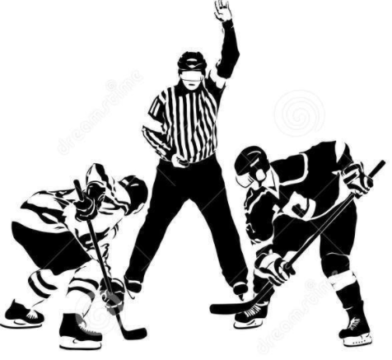
Role of LCMHL
Administration of League
Scheduling of all house level games
Provide rules & regulations around games
e.g., game length, stats, running clock etc.
League-level discipline
Oversee team placement in accordance with Hockey Eastern Ontario (HEO) Guidelines

Slide 4
2022-2023 Executive
President | Tom Stephens
Vice President | Vacant
Secretary | Jennifer Garner
Treasurer | Fiona Livingston
Webmaster | Andy Backa
Statisticians
U09 | Allyssia Chamberlain
U11 | Debbie Heuchert
U13 | Debbie Heuchert
U15 | Jenny James
U18 | Marie Côté
U21 | Jenny James
Presidents – APMHA, CPMHA, ORMHA, PLMHA, RMMHA, SMHA, WCMHA

Slide 5
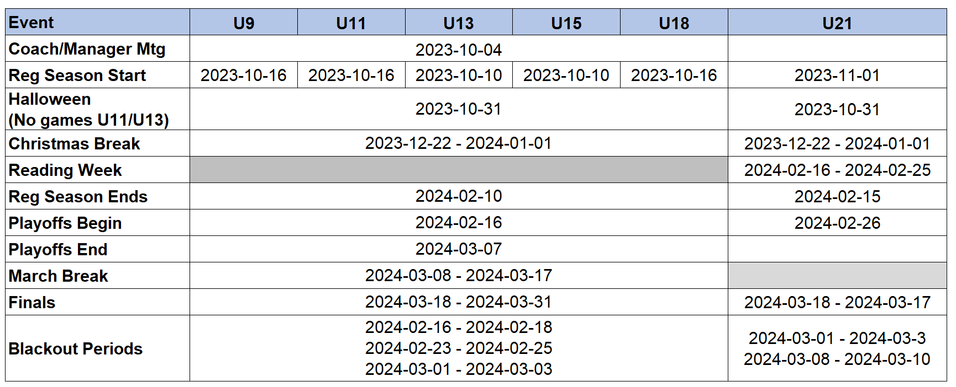
Important Dates
See this online at: League / Important Dates

Slide 6
LCMHL Handbook
One source of information:
LCMHL Constitution
By-Laws
Most importantly – Rules and Regs
Take the time to read the rules in their entirety
Most notably: rescheduling games, game precedence and playoffs.
Also outlines the escalation process!
***Currently under revision

Slide 7
Responsibilities of the Team Coach
All aspects of the game related to the team
Reporting all suspendable offenses to the district Suspension Reporting System (TTM)
Suspensions include: 10-minute misconducts, 5 minute majors, etc.
Reporting game results within 48 hrs. to the Goalline website
24 hrs. during playoffs
Rescheduling / switching games when necessary
Please use Game Reschedule & Switch Forms on website
Affiliation Tracking (of your affiliated player)
Most importantly…the conduct of the team and parents

Slide 8
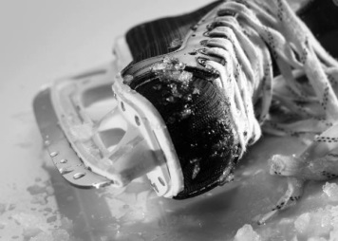
Affiliation
Club System
No rostering
Affiliation from within the association
Based on the D4 House League Affiliation Eligibility Chart
Affiliation up to a max of 15 games, excluding exhibition games
No limit on Goalies
Tracked within TTM
Must “register the call-up” within TTM prior to the game
A player’s coach is responsible for tracking the affiliations of his team members

Slide 9
Game Switching and Rescheduling
Useful Reference: LCMHL Rules and Regulations
Game Switching
Two visiting teams trade their games against the same home team
Requires no rescheduling of ice
Initiated by a visiting team – does not impact the schedule of the home team
Visiting teams must first attempt to switch a game before requesting a reschedule
Game Rescheduling
A game cannot be played and must be rescheduled
Home team/association responsible for providing a new ice slot
Impacts the schedule of both the home and visiting team
Both must be approved in advance by your League Statistician
Forms for each are available on LCMHL web site
Under For Teams / Game Switching and Reschedules

Slide 10
Switching Games
Must obtain prior consent from your divisional statistician
Must gain agreement from the other visiting team
Must complete the Game Switch Form
Must provide the form to the statistician no later than 72 hours before the switched game
The statistician will update the online schedule
The statistician will notify the home team
The home team cannot refuse to play the switched game(s)
Full details (and forms) are on the league website (For Teams menu)

Slide 11
Rescheduling Games
Requesting teams must make request to statistician
Statistician may approve or deny the request
Statistician approval must be obtained before engagement with another team
Exception: inclement weather reschedules
Full details (and forms) are on the league website (For Teams menu)
Policy
Prior to December 15 – No limit on reschedule requests
Post December 15 – Maximum of 2 reschedule requests

Slide 12
Rescheduling Games
Inclement Weather Re-scheduling:
Team officials must contact their statistician who has the authority to postpone games due to weather conditions.
If the statistician cannot be reached, team officials must contact the League President, Vice-President or the Treasurer or Secretary who also have the authority to postpone games.
The opposing team must be notified by the team official requesting cancellation due to inclement weather.
The team official will then contact the Referee Scheduler of their Association to advise the officials that the game has been postponed and will be re-scheduled.
NOTE: At no time may a team postpone a game on its own. If this is done the team will be subject to fine or suspension.

Slide 13
Game Protests & Appeals
Must be made to the League within 72 hours of relevant game
Must be in writing from the home association’s president or other designated official and addressed to the League President
Must clearly state the grounds upon which the appeal is being made and what aspect of the game, in particular, is being appealed.
The League will assess the appeal and determine whether or not it will be formally considered
Appeals of a frivolous or trivial nature will not be considered
Reference: LCMHL Playing Rules and Regulations, Appendix A

Slide 14
Game Sheets
Should be correctly completed and be legible
Instructions: http://cpmha.ca/files/fillingoutagamesheet_instructions.pdf
Must be entered into Goalline
Within 48 hrs (Regular Season)
Within 24 hrs (Playoffs)
You must enter exactly what appears on the game sheet
No corrections or other changes
LCMHL may perform a full audit if violations are suspected
Teams are responsible for keeping game sheets for a year

Slide 15
Penalty Minutes & Suspension
Penalty Minutes
Monitored monthly by the league
For teams that receive 50% more penalty minutes than the division average
The association and the team are notified
Disciplinary action may follow if improvement is not shown
Suspensions
The league has the right to add suspension games that are in addition to those specified in HEO’s Code of Discipline
Ensure you carefully track games served and are diligent at updating TTM with them

Slide 16
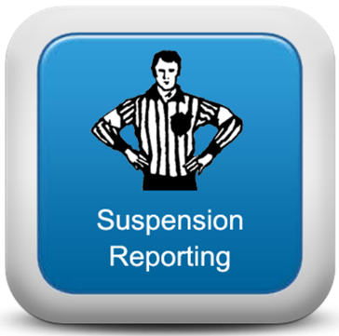
D4 Online Suspension Tracking System
Total Team Management (TTM)
Teams must report all suspendable offenses via TTM
Reporting must be done within 24 hrs. of each game
The system will indicate the # of games your player or bench staff will need to serve.
Teams must report each game served
LCMHL will reconcile the carry over into each new season
Access
Team accounts are set up each season
The system is accessed from
The D4 website (Team Staff Corner)
The LCMHL website (For Teams)
Users request their team password upon first-time access

Slide 17
District Perspective
Special Guest: Amanda Waterfield – D4 Chair

Slide 18
Tournaments
Priority is always given to league games
Tournaments must be approved by the league
Procedure
Obtain approval from the league statistician
Complete the online Tournament Request Form
Address conflicting league games via Switches and Reschedules
See league website (For Teams / Tournament Requests)
Caution
Note the blackout dates for the season (League / Important Dates)

Slide 19
Escalation
Situations
When you have concerns over a situation that you feel should be addressed
You have a voice, but protocol must be followed
Escalation Procedure
Wait 24 hrs. (“24 hour rule”)
Contact Association (convener, director, president)
Contact League
Please remind your parents!
They should always start by approaching the head coach

Slide 20
LCMHL Website
Goalline
The primary means to administer the League’s hockey activities
The definitive source for game schedules, announcements, etc.
League’s responsibility
Game Schedules
Statistics Reporting
League-wide Communication
Team Responsibility
Team Roster Maintenance ← Input your roster immediately
Team Contacts (Bench Staff) Maintenance
Reporting Game Results

Slide 21
LCMHL Website
Team Website Accounts
Details on website: For Teams / Obtaining a Team Account
Team Account Registration Form. Team Account Registration Form
Must minimally provide coach and manager contact information
Complete Form by:
Midnight October 9th (U13, U15)
Midnight October 16st (U9, U11, U18)
Coaches may be suspended until forms are completed.
Account Provision
Account credentials will be emailed to Head Coach and Manager
Expect it within a few days of registering your team

Slide 22
LCMHL Website
Team Roster, Team Contacts and Game Reports
Instructions on website under the For Teams menu
We’re Here to Help!
Problems or Questions: email LCWeb@lcmhl.ca

Slide 23
U9 Format
Regular Season
Half Ice format
4 on 4 hockey – continuous play
No Scoring
Three minute warm-up
Two 23 minute periods
Change ends between periods
Each period begins with a face-off
Only 2 faceoffs per game
Continuous clock
Buzzer every 90 seconds – Shift change
Often 2 simultaneous games - Both games are synchronized
Game sheets are required in case of major penalties

Slide 24
U11 Pathways Program
Preparation / Tryout / Development
Many restrictions that lead to a later start to the regular season
Cannot begin conditioning until after labour day
4 skills sessions, 3 evaluation sessions, 5 team practices
Regular Season
20 games
1:1 ratio of practices to games
Difficult to precisely follow
We’re forced to take an “on average” approach
Playoffs
Tournament style structure

Slide 25
Ref’ing Perspective
Special Guest: Lou Matura – D4’s Referee-in-Chief

Slide 26
Coaching Tool
Special Guest: Steve Edgerton – D4’s Coach Mentor

Slide 27
Let’s Play Hockey
Schedules
Are planned to be posted 3-4 days before a division’s start date
Please Remember: SCHEDULES ARE SUBJECT TO CHANGE.
Always check with game times on Goalline website
Have a Safe and Fun Season
Thank you for volunteering

